Slide 1
Data Analytics for Secure Decision-Making in Network Management
Your Name: Saif Kamal Salim Haddad
Your ID: 21110214
Date: 12-8-2023

Slide 2
Introduction
In this assignment, my target in this assignment is to make descriptive analytics for the given data set that talks about cybersecurity attacks, which means finding out patterns in the data set to come out with insights.
The importance:
By using descriptive analytics we will be able to know patterns and trends to know when each attack happens and based on what, allowing for early detection.

Slide 3
Data Analytic Activities, Techniques, and Tools

Slide 4
Data Analytic Activities
Data modeling: Data modeling is the process of transforming and organizing data to get insights (Grouping, Filtering)
Data exploration: involves studying the dataset for understanding its content, structure, and distributions.(df.info() and df.describe())
Data visualization: Making graphical representations for data visualization helps to clearly explain the insights and patterns found in the data. (Bar Plots, Pie Charts, Histograms)

Slide 5
The techniques used
descriptive analysis:
Data Summary and Information: df.info() and df.describe() provides a concise summary of the dataset
exploratory data analysis:
Data Visualization: creating (bar plots, pie charts, histograms)
Frequency Analysis: value_counts() to calculate the count of unique values in categorical columns ('Type', 'behaviour', 'Event').
Statistical Analysis: Calculation of Statistics: Calculating statistics such as mean, median, mode, and maximum for numerical variables like what I did in the energy consumption feature
Data Filtering :
Filtering Data: Subsetting the dataset to include specific rows based on conditions, such as filtering for 'Flooding' attack type or 'S_Node' values.
discover patterns, relationships,

Slide 6
Tools used
Python: it is the language, it was the core of this project and was used to finish the descriptive task
Pandas: it is a library for data manipulation and analysis, it allows me to make data frames to make the data analysis and data handling easier
Matplotlib: it is a plotting library, it allows for showing statics and relation by its plots that make the data analysis easier
Seaborn: it is a high-level plotting library for showing statistical graphics, it is sometimes used for complex visualizations. It is fully built based on the Matplotlib library

Slide 7
A brief discussion on why Python is popular in the data analytics industry
Python and its usage in the industry:(bmc., 2022) (Terra, 2023)
Ease of Use: easy language, easy writing, easy understanding = faster results.
Strong Data Manipulation: Having a strong tool for analyzing data such as pandas that transfer data into data frame = easier work with tabular data(bmc., 2022) (Terra, 2023)
Data Visualization Capabilities: the python language has a lot of libraries that help data scientists to employees create graphical displays of the insights which make it easier to translate everything to the stakeholders in a business language in an effective language.
Open source: (bmc., 2022) (Terra, 2023)
it is free for everyone which is a benefit for
data analytics workers: teach and practice at no cost
Stakeholders: get what they need and finish tasks with no cost
Decrease employees number and cost: the python language can be used for data analytics and also for machine learning so they can solve multi-tasks in one language(bmc., 2022) (Terra, 2023)

Slide 8
Data Analytics in Industry

Slide 9
Data Analytic Methods
Data Analytic Methods:
Descriptive Analytics: involves studying past data to understand trends and events, giving insights into what happened in a business(Stevens et al., 2023) (Kelley, 2023)
Predictive Analytics: Predictive analytics uses past data and models to predict future outcomes
(Stevens et al., 2023) (Kelley, 2023)
Prescriptive Analytics: expands predictive analytics by offering recommendations for the best course of action. (Stevens et al., 2023) (Kelley, 2023)

Slide 10
Use of these methods in the industry, specifically in cybersecurity
Data Analytic Methods usage in cybersecurity :
Descriptive Analytics(Stewart, 2023)
examining previous cyberattacks to comprehend how they happened.
identifying the methods that hackers have previously used.
list the many ways that attacks occurred in the past.
Predictive Analytics:(Stewart, 2023)
guessing about possible future cyber risks through studying trends.
use historical data to discover new tactics that hackers could use.
making predictions about possible hacker tactics.
Prescriptive Analytics:(Stewart, 2023)
recommending actions to do when a cyber attack is discovered.
explaining to the cybersecurity team how to prevent and stop an attack.
helping the team in making the wisest decisions for safety based on rules and predictions.

Slide 11
Exploratory Data Analysis Techniques (EDA)

Slide 12
Explanation and importance of EDA data analysis
Explanation of EDA data analysis:
EDA involves visually and statistically analyzing data to find patterns, and correlations, and describe its key features. (exploratory, 2022) (Packt subscription)
Importance:
Data Understanding: Improvements of Data Understanding such as we can know the type of values, and their structures (exploratory, 2022) (Packt subscription)
Data Quality Assessment: by knowing if we have: outliers, and missing values so we can work on accurate data(exploratory, 2022) (Packt subscription)
Pattern Recognition: helps highlight trends and patterns to come out with insights
(exploratory, 2022) (Packt subscription)
Decision-Making: based on the insights that we come out with
Answering problems: (exploratory, 2022) (Packt subscription)
Risk Assessment: decreasing risks by finding patterns, especially in cybersecurity

Slide 13
EDA Techniques used
Techniques used in this analysis (like histograms, scatter plots, etc.) with explanation.
Summary Statistics: such as data frame info and data frame description were used to show the dataset's summary information also data types, and missing values to make sure that the data is accurate also I used Max to see the maximum value for the energy consumption for the flooding attack
Bar Plots: were used to visualize this distribution of the attack types based on all data which was in the column
Pie Chart: was used to visualize this distribution of the attack types based on all data which was in the column but by percentage
Histogram: was used to visualize this distribution of the 'energy_consumption' values for 'Flooding' attacks.
Frequency Analysis: Was used to count the number of times that category values in columns like behavior, Type, and Event happened.

Slide 14
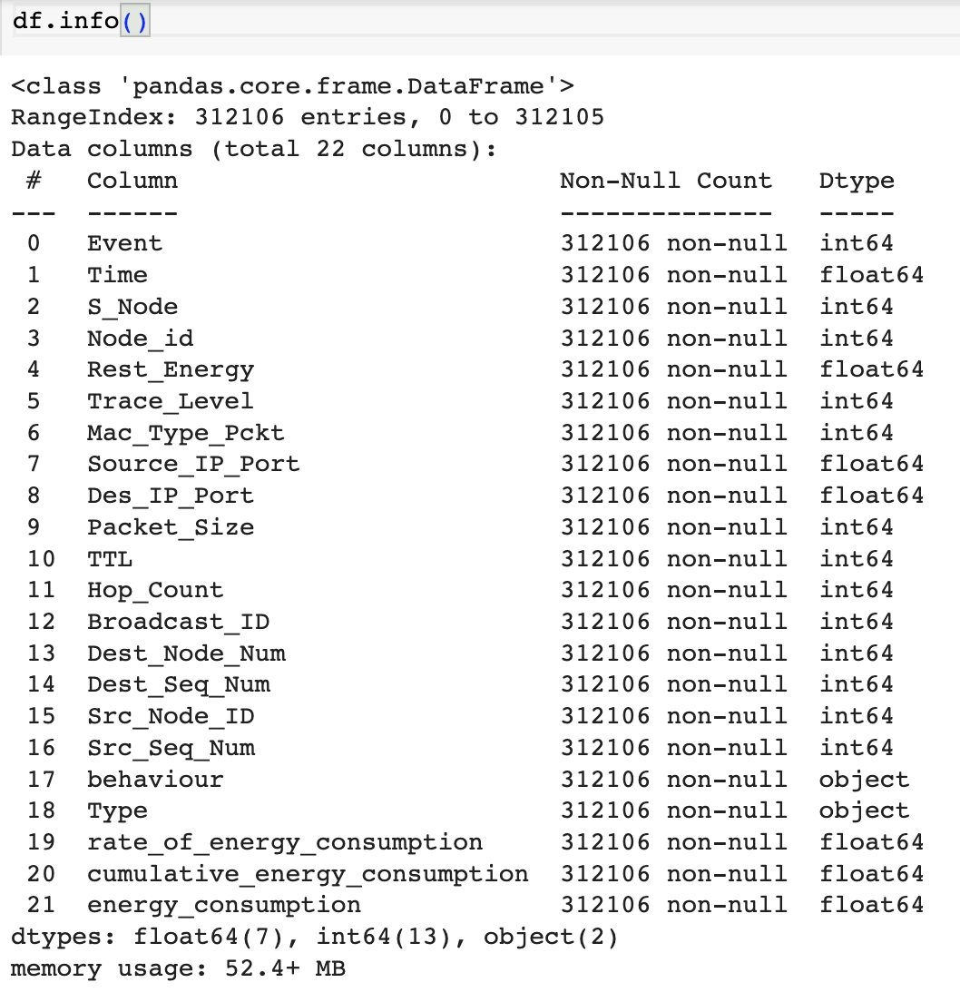
EDA Examples
Summary Statistics:
info: was used to know how many features I have and what is the data type of each feature.

Slide 15
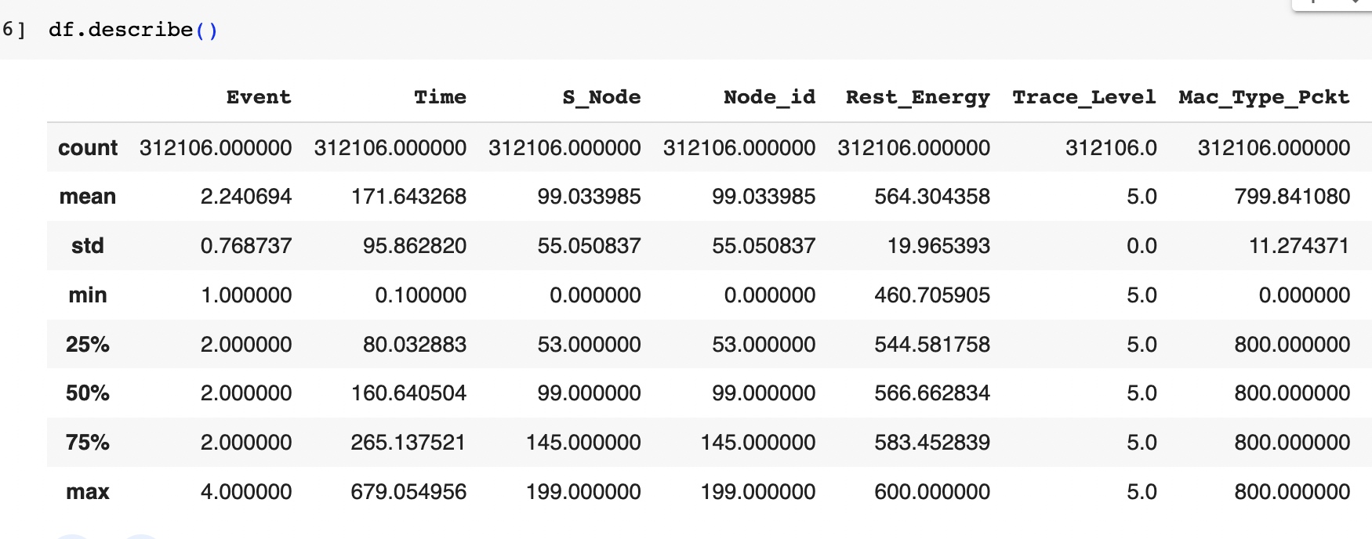
Summary Statistics:
description: was used to know the mean information for each feature such as the mean, std, min count, max. in concluding the mean information to overview a feature for the first time.
.

Slide 16
Summary Statistics:
Max: was used to know to know the highest energy consumption when there was a flooding attack.
.

Slide 17
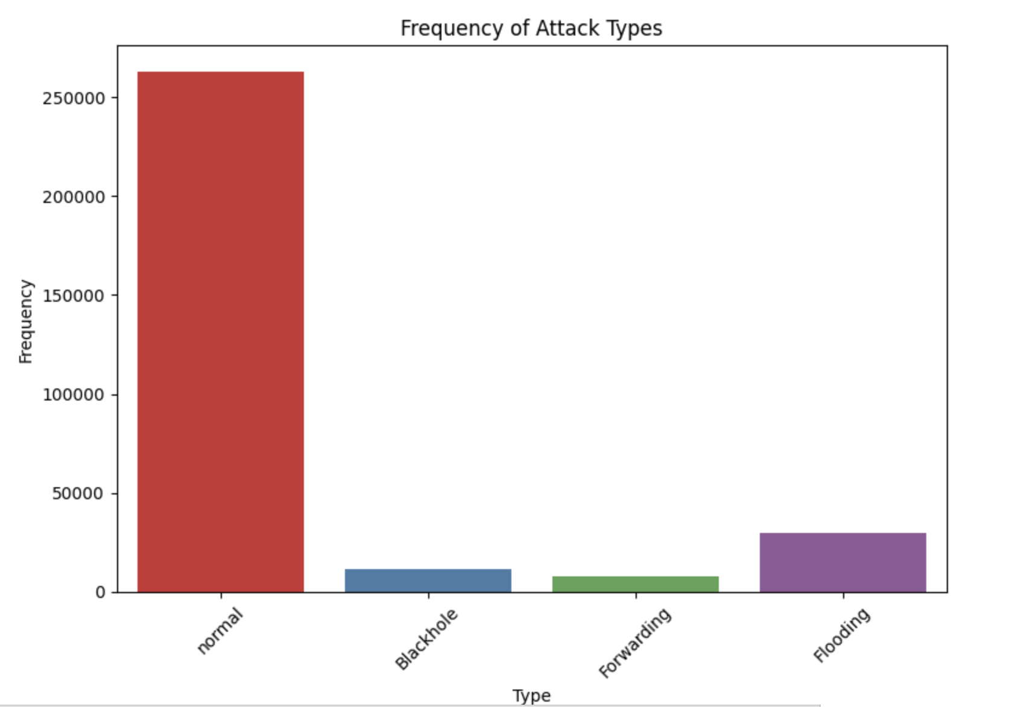
Bar Plots
This bar plot was made to understand what types of
attackes we have and how much we have from each (count)
And to know what the most attack and what the least attack

Slide 18
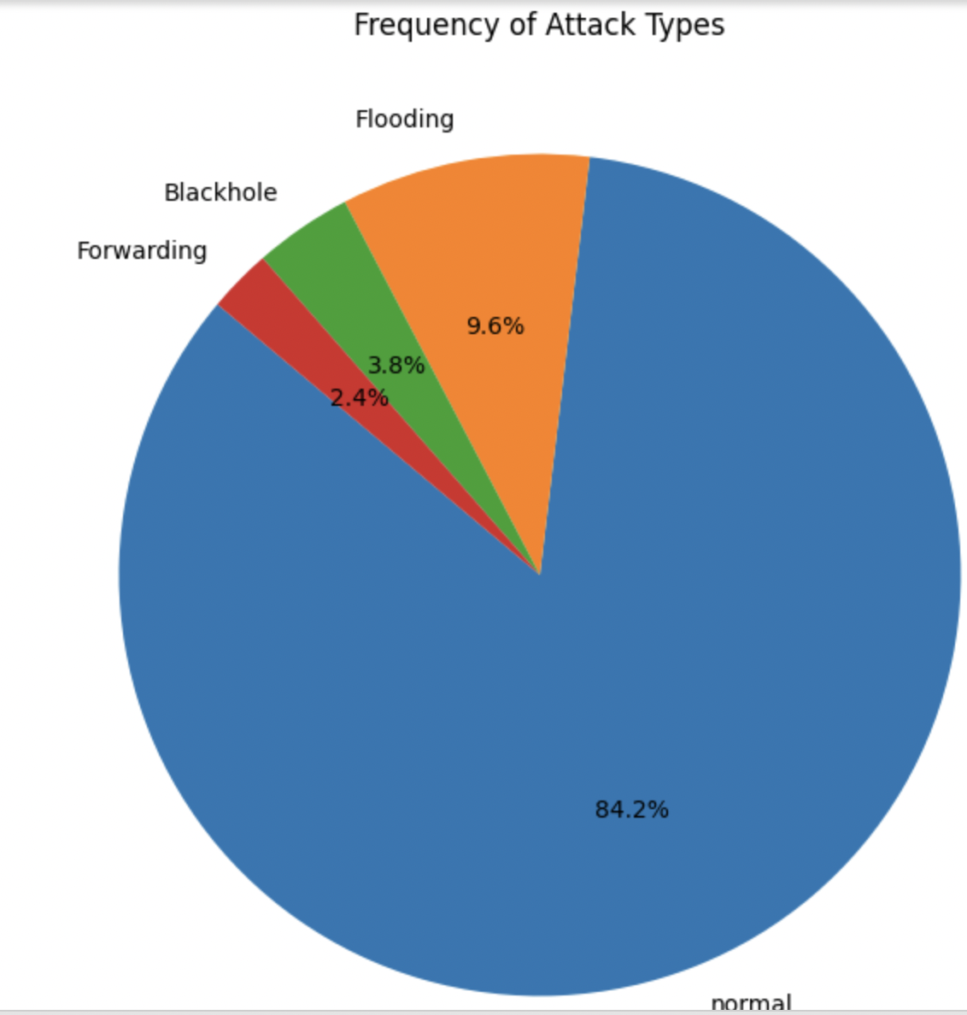
Pie Chart
This pie chart was made to understand what types of
attackes we have and how much we have from each (count)
And to know what the most attack and what the least attack
But by persantage

Slide 19
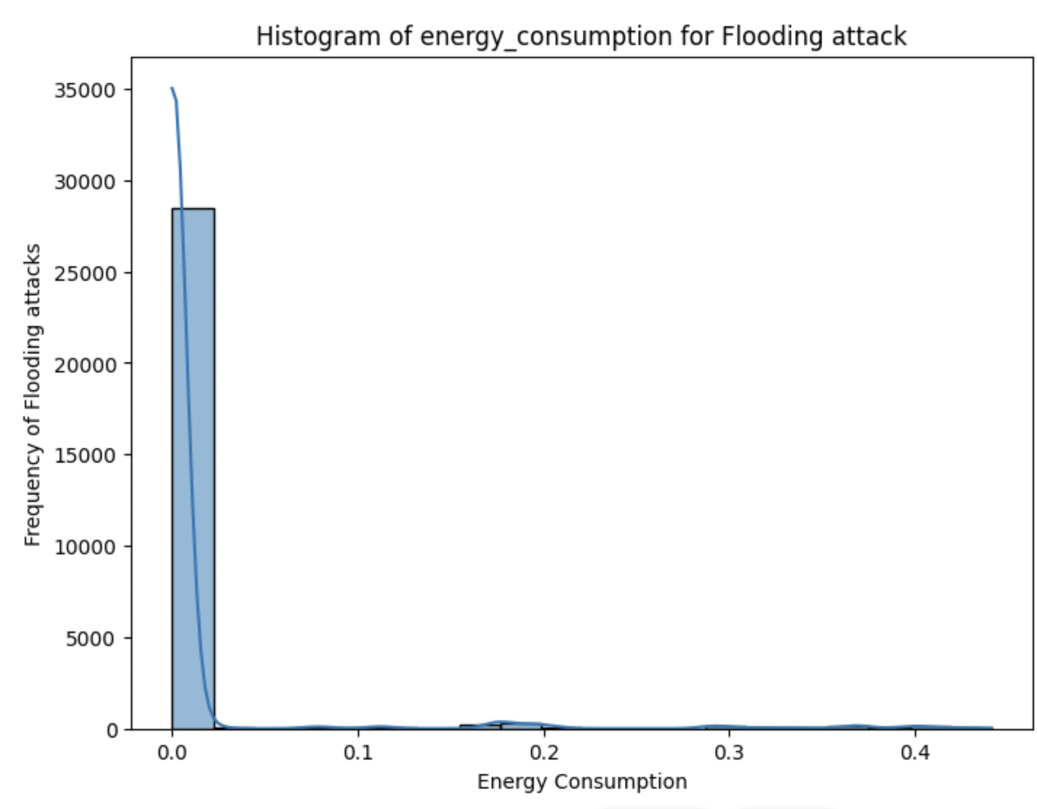
Histogram
This Histogram was made to understand the distribution
between the 'energy_consumption' values for 'Flooding’
Attacks and what is the highest value of 'energy_consumption’
When there was a flooding attack and to know what was the
Most repeated value of the 'energy_consumption’ based
On the flooding attack

Slide 20
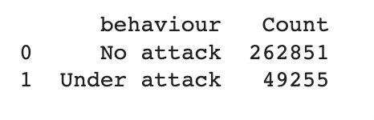
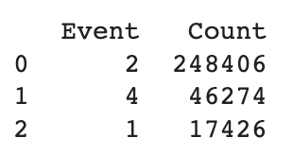
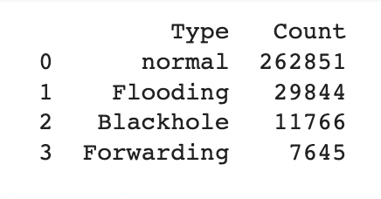
Frequency Analysis:
Frequency Analysis was applied on three-column behavior,
Type, and Event and it was used to see how much value we
have in each column and how much each value was repeated.
Behavior: Event:
Type:

Slide 21
Descriptive Analytic Techniques

Slide 22
Descriptive Analytics: Techniques and Decision-Making Importance
Measures of Frequency: used to see how much value we have in each column and how much each value was repeated. (Ramakrishnan, 2023) (NetSuite.com)
Measures of Central Tendency: it shows the center or the average of the dataset. (Ramakrishnan, 2023) (NetSuite.com)
Measures of Position: are statistical variables that specify where a certain data point or observation is located inside a dataset. (Percentile, Quartile, Z-score, Decile) (Ramakrishnan, 2023) (NetSuite.com)
Contingency Table: is a particular kind of table that shows the relationships between several categories of variables by the count of each (Ramakrishnan, 2023) (NetSuite.com)
Measures of Dispersion: Calculate how far apart the data points are from the center value. (Ramakrishnan, 2023) (NetSuite.com)
Outlier Detection: shows the data points that are significantly out of the rest of the data (Ramakrishnan, 2023) (NetSuite.com)

Slide 23
Importance of Descriptive Analytic Techniques in decision-making
Pattern Recognition: These techniques find patterns, trends, and relationshipsNetSuite.com)
Data Summarization: making it simpler for decision-makers to comprehend and efficiently evaluate the data.
NetSuite.com)
Performance Evaluation: By analyzing historical data, can evaluate their performance, measure progress, and set our goals NetSuite.com)

Slide 24
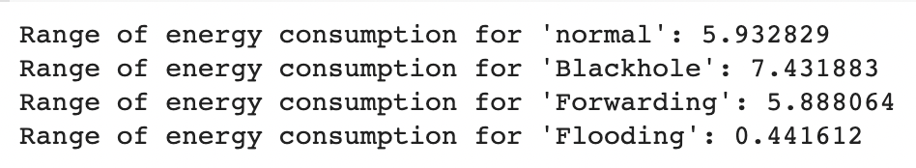
Descriptive Analytic Techniques used
Measures of Frequency: I use this to count the values in these features behavior, Type, and Event columns
Measures of Central Tendency: I used it to calculate the mean and the mean and median and the mode or the energy consumption feature when there was a flooding attack
Contingency Table: I used it to show the count of different attacks for some specified S nodes values
Measures of Dispersion: i used it to re the range of the energy consumption for each attack

Slide 25
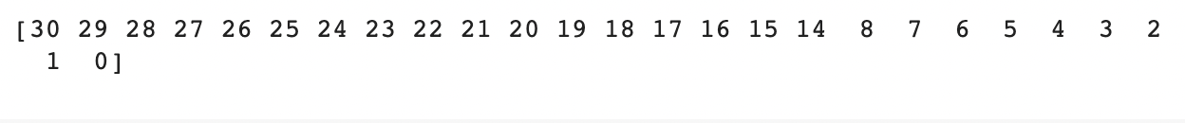
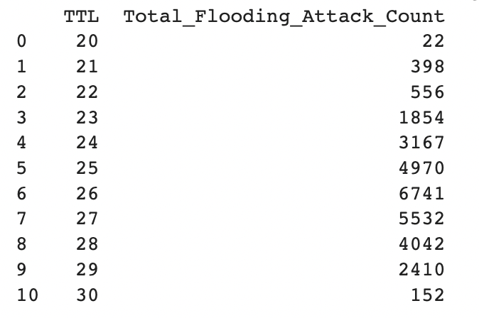
Feature Analysis
TTL:

Slide 26
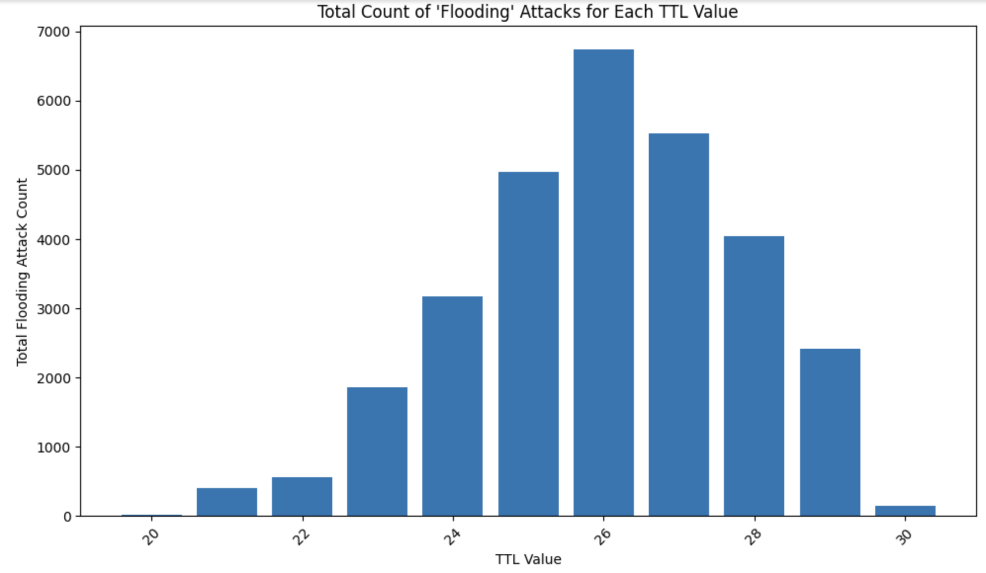

Slide 27
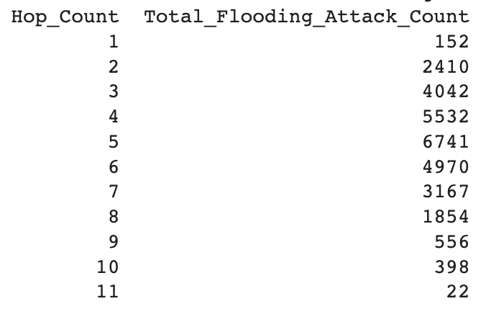
Hop count:

Slide 28
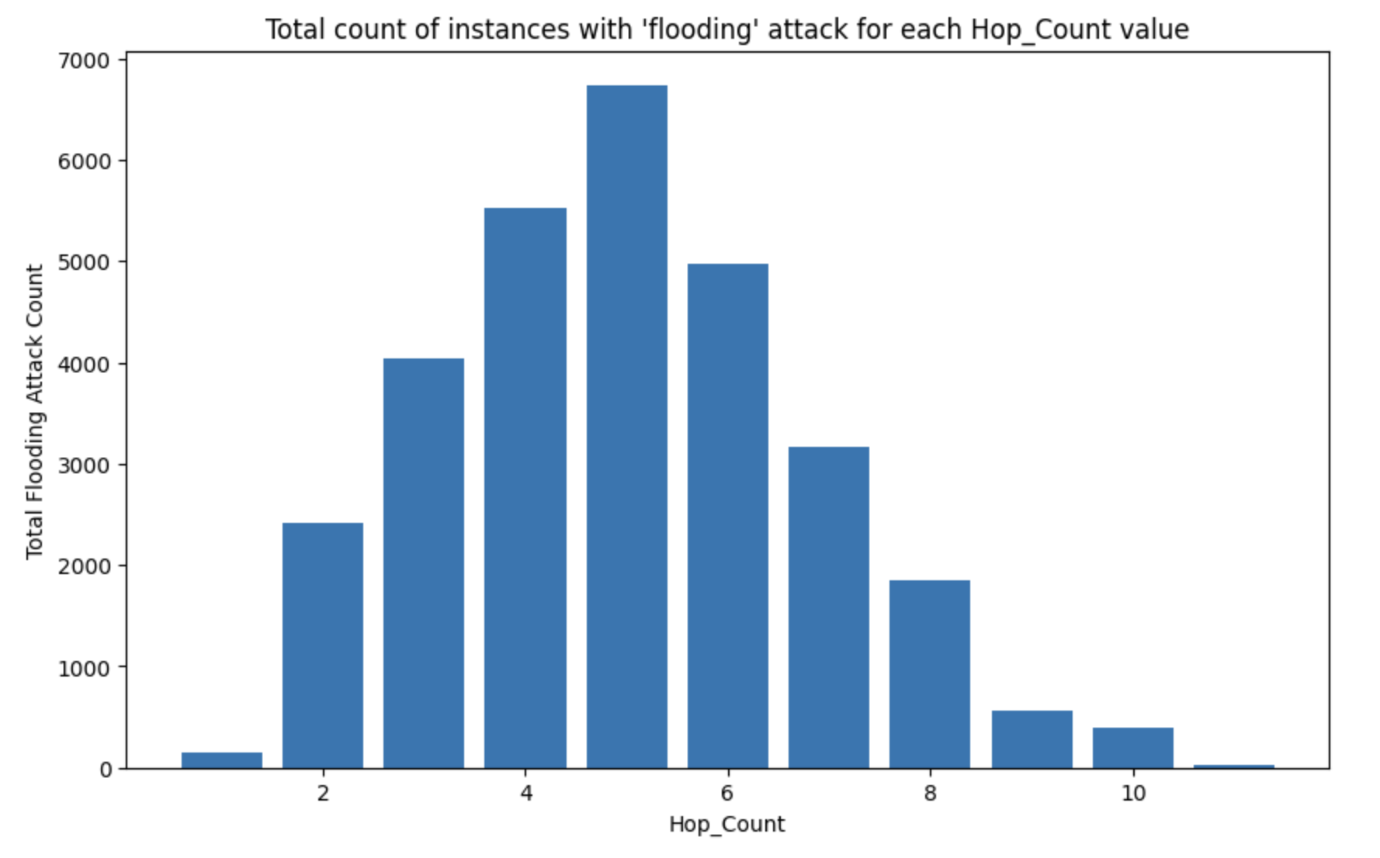

Slide 29
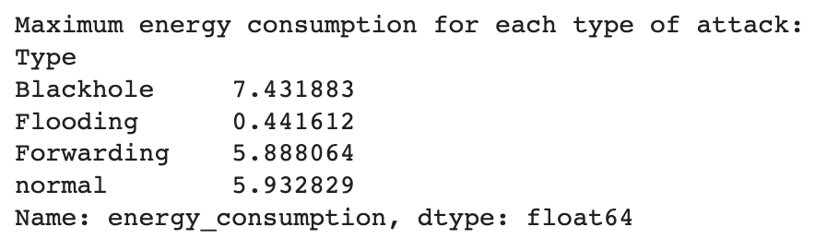
Energy consumption:

Slide 30
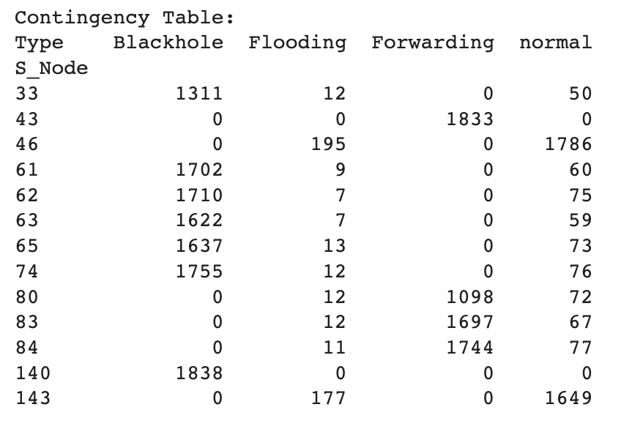
Association Analysis
concept of a contingency table: Similar to a chart, a contingency table shows how two features are being linked(Contingency table) (Stephanie, 2023)
concept of association measures: is comparable to the tools we employ to determine if two features are related or not(Contingency table) (Stephanie, 2023)
This is my contingency table:
I have found that in these values of S nodes the flooding attack
is so small comparing it with the other types of attack so
when we have these values of the S node it is likely not to
be a flooding attack and it is more likely to be other type of
attack or with no attack

Slide 31
Role of Analysis in Decision Making
By discovering that flooding assaults are more likely to happen when TTL values are between 20 and 30, you've identified a particular range that calls for more monitoring.
Actionable insights may be gained from the finding that flooding assaults are more frequent when hop counts are between 1 and 11.
A clear guideline for anomaly identification is provided by highlighting event values 2 and 4 as being related to flooding assaults.
A useful indication is the determination of a maximum energy consumption threshold of less than 0.441612.
and S Node value except [43, 140, 80, 83, 83, 84, 33, 61, 62, 63, 65, 46, 74,143]
be careful you are at risk of getting attacked by a flooding attack and as I found that the flooding attack has the highest value so need to find a way to avoid it
Discuss its significance with examples from your findings, pointing out how these can be applied to a business context

Slide 32
Proofing for the cybersecurity employees:
These are the S nodes values that you don’t have to detect them
These are the Hob cout that you have to detect them

Slide 33
These are the TTL values that you have to detect them
This discovery can lead to the creation of unique
security rules that, when applied, cause alarms or
take precautionary measures when TTL values fall
within a certain range. By focusing resources on
potential threats and minimizing false positives,
this tailored strategy improves incident response.
Energy consubtion must be under 0.441612:

Slide 34
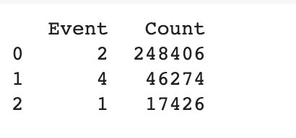
Watch out when the event value is 2,4
So you can set their intrusion detection systems to prioritize events with values 2 and 4.

Slide 35
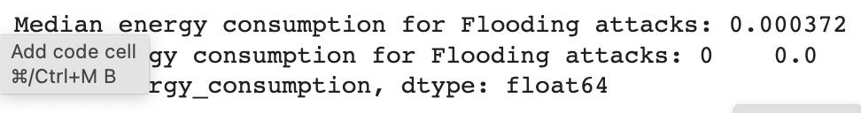
Importance of Data Analytical Techniques to Decision-Making
Discuss specific examples where these techniques might influence management or business decisions, specifically in cybersecurity.
All the data analytic techniques were very helpful for me to find patterns and trends and also to understand the data but not all of them drive me to a concluding
Measures of Central Tendency: was so helpful in making me find the pattern which is some S nodes values don’t have any flooding attacks or they have a very small amount which makes me know
Measures of Dispersion: this also was one of the helpful techniques to make me take a decision I found through this the range of the energy consumption for each attack which make me take a decision that the flooding attack’s maximum energy consumption is the least between them so the if the energy consumption was over this number 0.441612 it won’t be flooding.
Measures of Central Tendency: this was also very helpful, I used this to calculate the median of the TTL when there was a flooding attack and by this, I found that if the TTL value is 26 there is a high possibility that there are t flooding attack

Slide 36

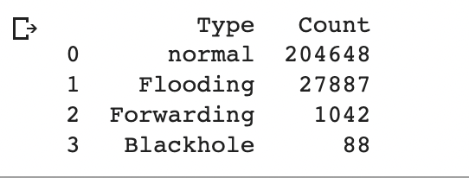
Providing the decision
As you can see that the count of the flooding count before applying my roles was 29844
But after applying the roles I have caught 27887, which is 0.93442568 percent.

Slide 37
Conclusion
Summary of key findings
TTL value: Between 20 – 30
Hop count: Between 1 - 11
Energy consumption max value: Under 0.441612
Event value: 2, 4
S Node: any value except [43, 140, 80, 83, 83, 84, 33, 61, 62, 63, 65, 46, 74,143]
Overall impact of your analysis on network security and performance
Attack Detection and Prevention:
Optimized energy Usage: must have a stable usage of energy
Effective Traffic Management: no errors in delivery
Mitigating Downtime:
Any potential future work based on your findings
I will work on the other types of attacks to find exactly when every attack happen to have a healthy and strong network and connection without any errors

Slide 38
References
bmc., bmc. (2022) https://www.bmc.com/blogs/python-big-data-analytics/.
Terra, J. (2023) Python for data science and data analysis, Simplilearn.com. Available at: https://www.simplilearn.com/why-python-is-essential-for-data-analysis-article (Accessed: 12 August 2023).
Stevens, E. et al. (2023) The 7 most useful data analysis techniques [2023 guide], CareerFoundry. Available at: https://careerfoundry.com/en/blog/data-analytics/data-analysis-techniques/ (Accessed: 12 August 2023).
Kelley, K. (2023) What is data analysis?: Process, types, methods, and Techniques, Simplilearn.com. Available at: https://www.simplilearn.com/data-analysis-methods-process-types-article (Accessed: 12 August 2023).
Stewart, A. (2023) Cyber Security Data Analytics: Fast becoming a business requirement, TechBrain. Available at: https://www.techbrain.com.au/cyber-security-data-analytics/ (Accessed: 12 August 2023).
exploratory, exploratory (2022) What is exploratory data analysis?, IBM. Available at: https://www.ibm.com/topics/exploratory-data-analysis#:~:text=The%20main%20purpose%20of%20EDA,interesting%20relations%20among%20the%20variables. (Accessed: 12 August 2023).
(No date) Packt subscription. Available at: https://subscription.packtpub.com/book/data/9781789537253/2/ch02lvl1sec04/the-significance-of-eda (Accessed: 12 August 2023).
Ramakrishnan, M. (2023) What is descriptive analytics all about?, Emeritus Online Courses. Available at: https://emeritus.org/blog/business-analytics-what-is-descriptive-analytics/ (Accessed: 12 August 2023).
NetSuite.com (no date) Descriptive Analysis defined, Oracle NetSuite. Available at: https://www.netsuite.com/portal/resource/articles/erp/descriptive-analytics.shtml (Accessed: 12 August 2023).
Contingency table (no date) Contingency Table - an overview | ScienceDirect Topics. Available at: https://www.sciencedirect.com/topics/computer-science/contingency-table (Accessed: 12 August 2023).
Stephanie (2023) Contingency table: What is it used for?, Statistics How To. Available at: https://www.statisticshowto.com/what-is-a-contingency-table/ (Accessed: 12 August 2023).

